Slide 1
City of Plainview, TX
Council Workshop on Ameresco Project
March 9, 2023

Slide 2
Project Goals
Upgrade Aging Infrastructure
Reduce Utility & Operating Cost
Proactively Address Deferred Maintenance
Enhance Service & Transparency to Citizens
Water Conservation
Field Verification of EPA Lead & Copper Compliance

Slide 3
Process Followed & Future Steps
Sign Contract
Project Development Agreement Signed September 2022
Meter Testing, Detailed Analysis, & Scope Development
Implementation
Guarantee Phase
RFQ or Co-Op
Cooperative Purchasing Agreement
(TIPS)
Staff Recommendation
3rd Party Engineering Review Completed
= Future Steps
= Previous Action

Slide 4
Audit & Development Process Details
Goal Setting & Data Collection
Identify and Define Project Goals
Site Surveys & Field Work
Field Survey
Technology & Scope Reviews
Initial Scope Discussions
Current Stage in Process
Review Pricing Received
Narrow Down Scope
Vendor Presentations
Technology Demo’s
Meter Testing
Data Analysis
Propagation Study
Discuss Challenges & Needs
Establish Timeline
Issued Bids
Create & Finalize Savings
Collect Data
Final Selections

Slide 5
Infrastructure Reviewed
Water Meters/AMI
Replacement of Meters/Boxes/Vaults
Advanced Metering Infrastructure (AMI)
Facility Measures
Lighting Retrofits
HVAC Replacements
Building Automation / Controls
Window Replacements
Other Measures
Energy Usage at WWTP
Solar & Renewable Energy
Building Water Conservation & Irrigation
Why Needed
Equipment beyond useful life
Address deferred maintenance
Be proactive in infrastructure replacements
Reduce loss & unaccounted for water
Reduce energy & operational costs
Improve indoor air quality
Provide greater transparency for Citizens
Enhance response time to Citizens and staff

Slide 6
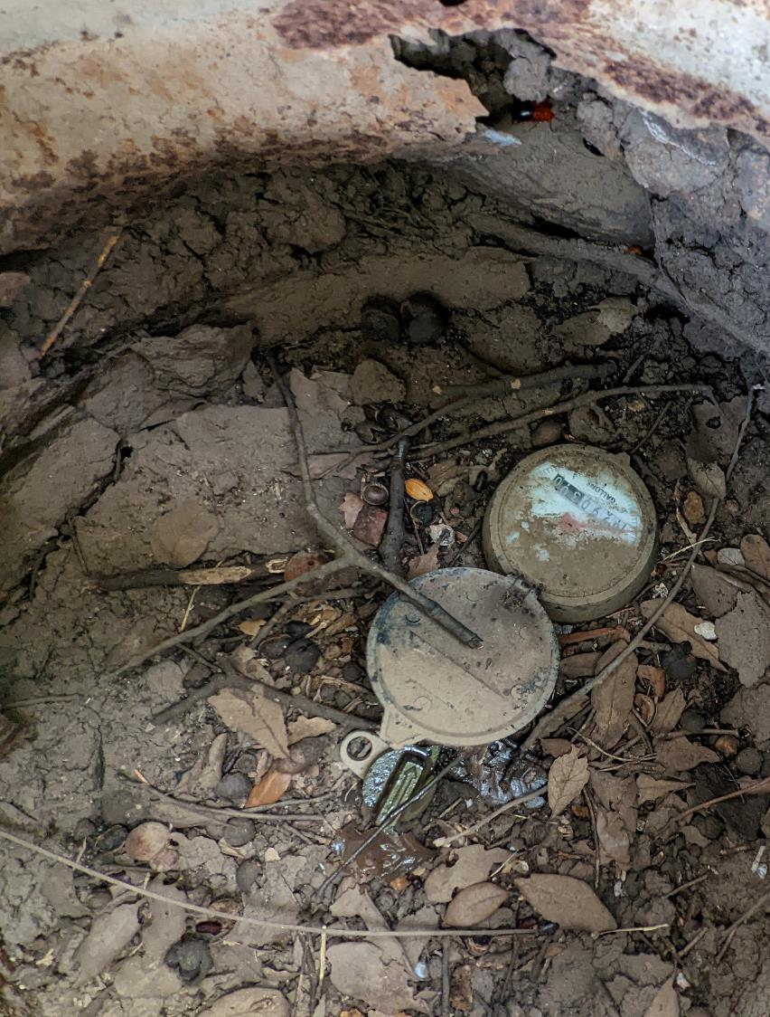
Field Conditions of Water Meters

Slide 7
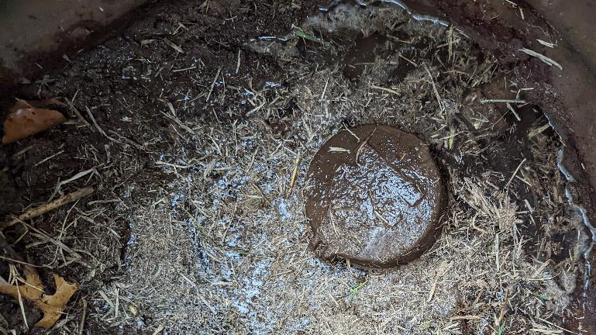
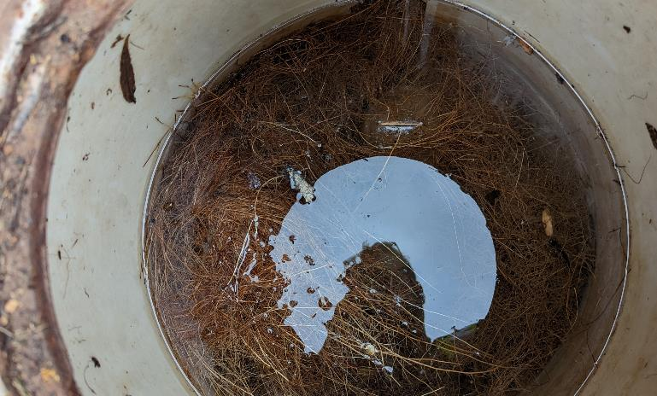
Current Field Challenges & Examples
Flooded Boxes
Meter Access
Tight Conditions
Broken Boxes
Foggy Glass
Broken Lids
Boxes full of Dirt
Tight Conditions
Flooded Box

Slide 8
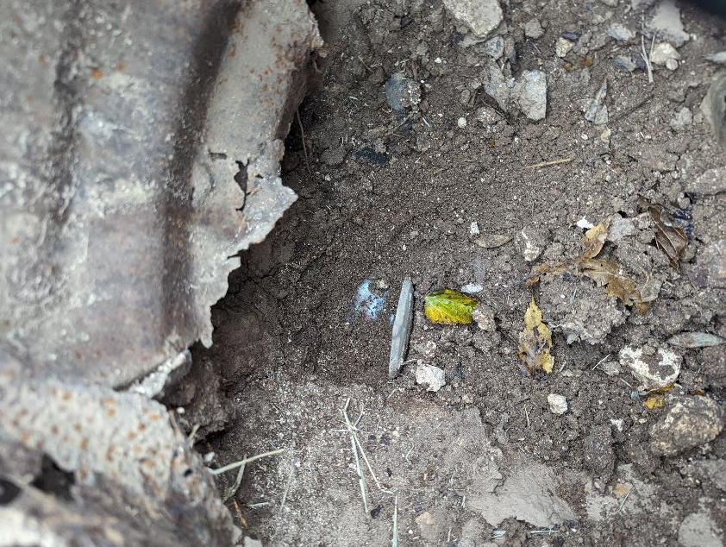
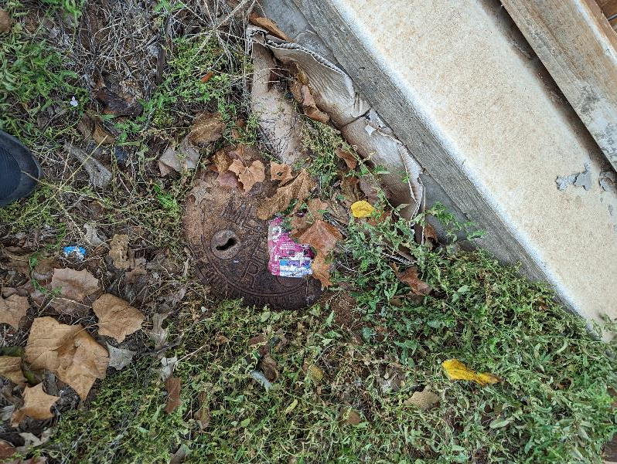
Current Field Examples
Difficult box reset condition
Tight conditions & box will need to be replaced and reset

Slide 9
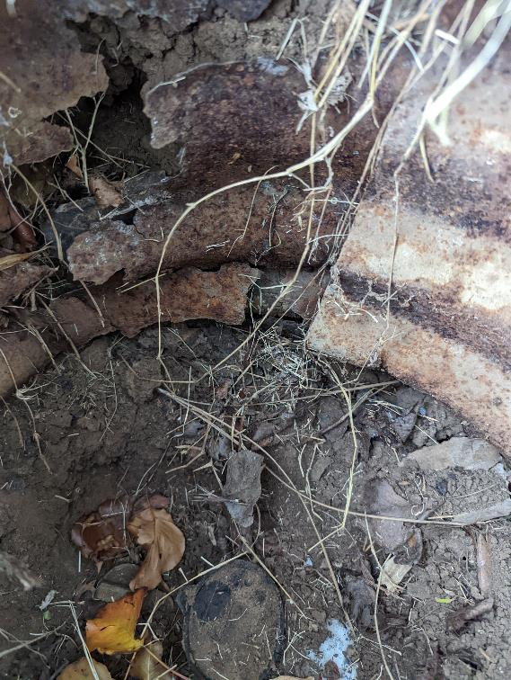
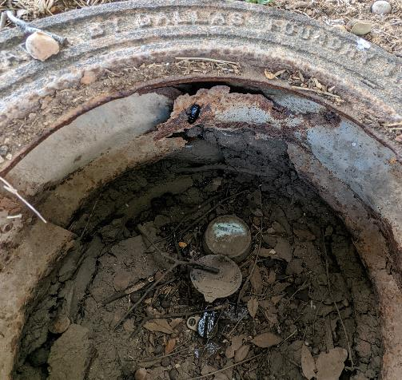
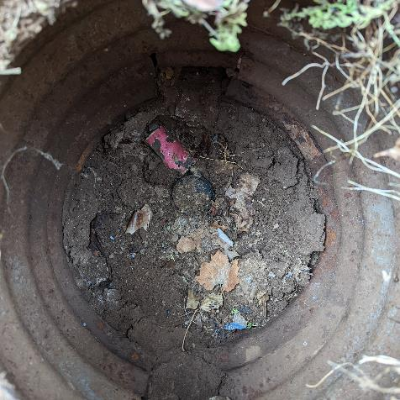
Current Field Examples
Box Damage and Debris
Box damage allowing mud and debris

Slide 10
Large Meter Challenges
Vaults crumbling, rotten, or failing
No bypasses - creates operational challenges
Very few have test ports
Access issues hinder maintenance & change out of meter
Safety hazards
Meter Size | Quantity
3" | 17
4" | 31
6" | 14
8" | 1
Grand Total | 63

Slide 11
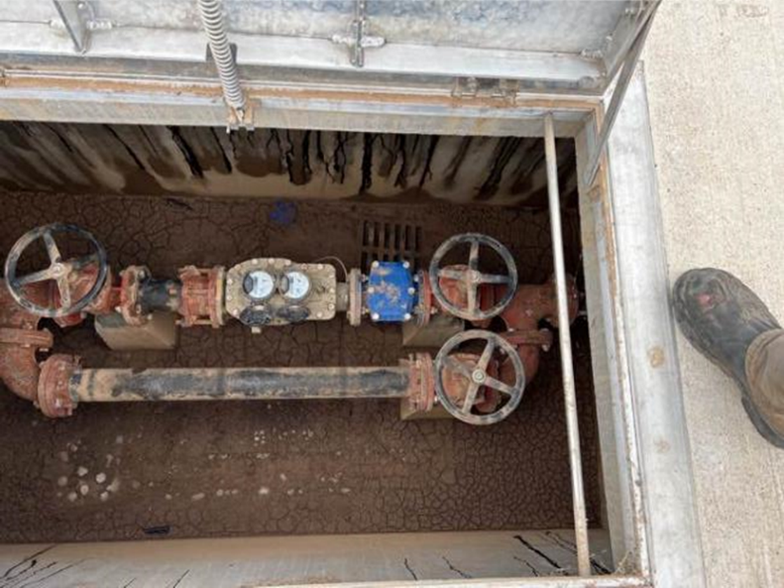
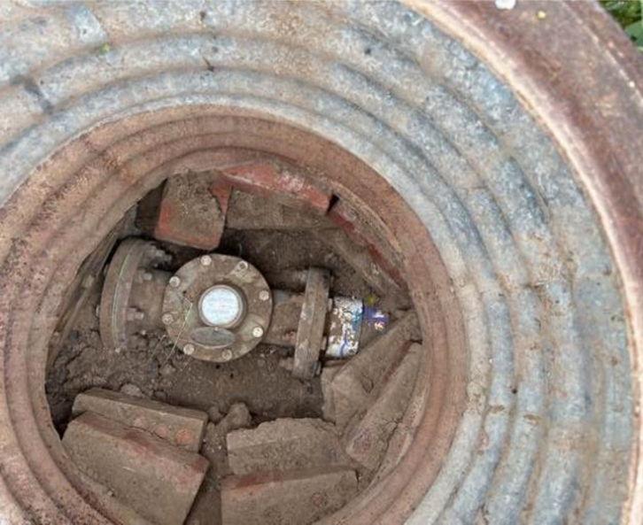
Large Meter Vault Challenges
Vault in Good Shape
Vault failing, meter access issues, no bypass, shutoff valve not accessible, etc.

Slide 12
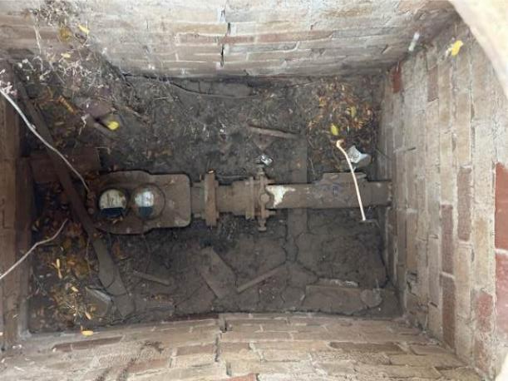
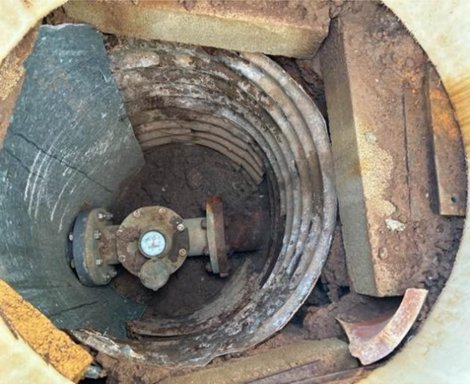
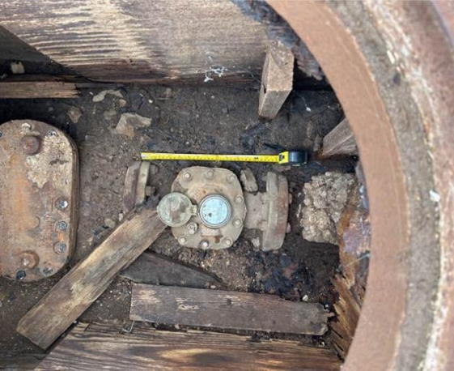
Large Meter Vault Challenges – Cont.
Vault failed and meter access issues
Vault failing and meter access issues
Sides caving in & no bypass

Slide 13
Meter/AMI Scope Overview

Slide 14





How the System Works AMI System Overview (Advanced Metering Infrastructure)
Meter Data Management Platform - Cloud
Water Meter w/ Radio
Utility Bill
Base Station or Cellular Tower
Utility Billing
Customer Portal
(smart phone / tablet enabled)
Notes:
Chad

Slide 15
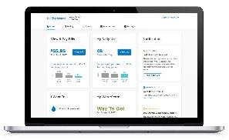
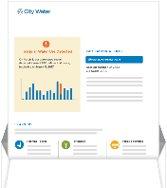
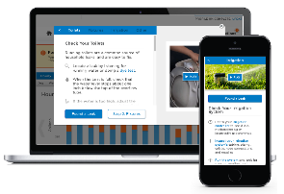
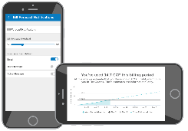
WaterSmart Portal will Enhance Customer Experience
Allow Customers to have transparent access to consumption information, leak detection, high usage alerts, historical patterns, and bill predictions all using a web portal on your computer and mobile devices.
Customer Portal provides personalized water use information and tips
Water Reports, Customer Letters, & Print Leak Alerts drive customers to the Portal
Alerts can be sent in all channels
(print, email, voice, text)
Leak Resolution & Bill Explainer help customers to resolve common issues online

Slide 16
Meter Scope of Work – General Overview
METER COUNTS TABLE
ADDITIONAL SCOPE ITEMS
Integration of all data points
Old Read / New Read, serial numbers, size, etc.
Pictures of installs (before & after)
Sub-meter accuracy GPS coordinates
Identify Pipe Type on Both Sides of the Meter (per EPA requirement)
Ancillary materials (where needed gaskets, box cleanout, curb stops, etc.)
New Meter Boxes and Lids for meters 2” and smaller
New vaults for 21 large meters
Customer Portal

Slide 17
Facility & Building Opportunities

Slide 18
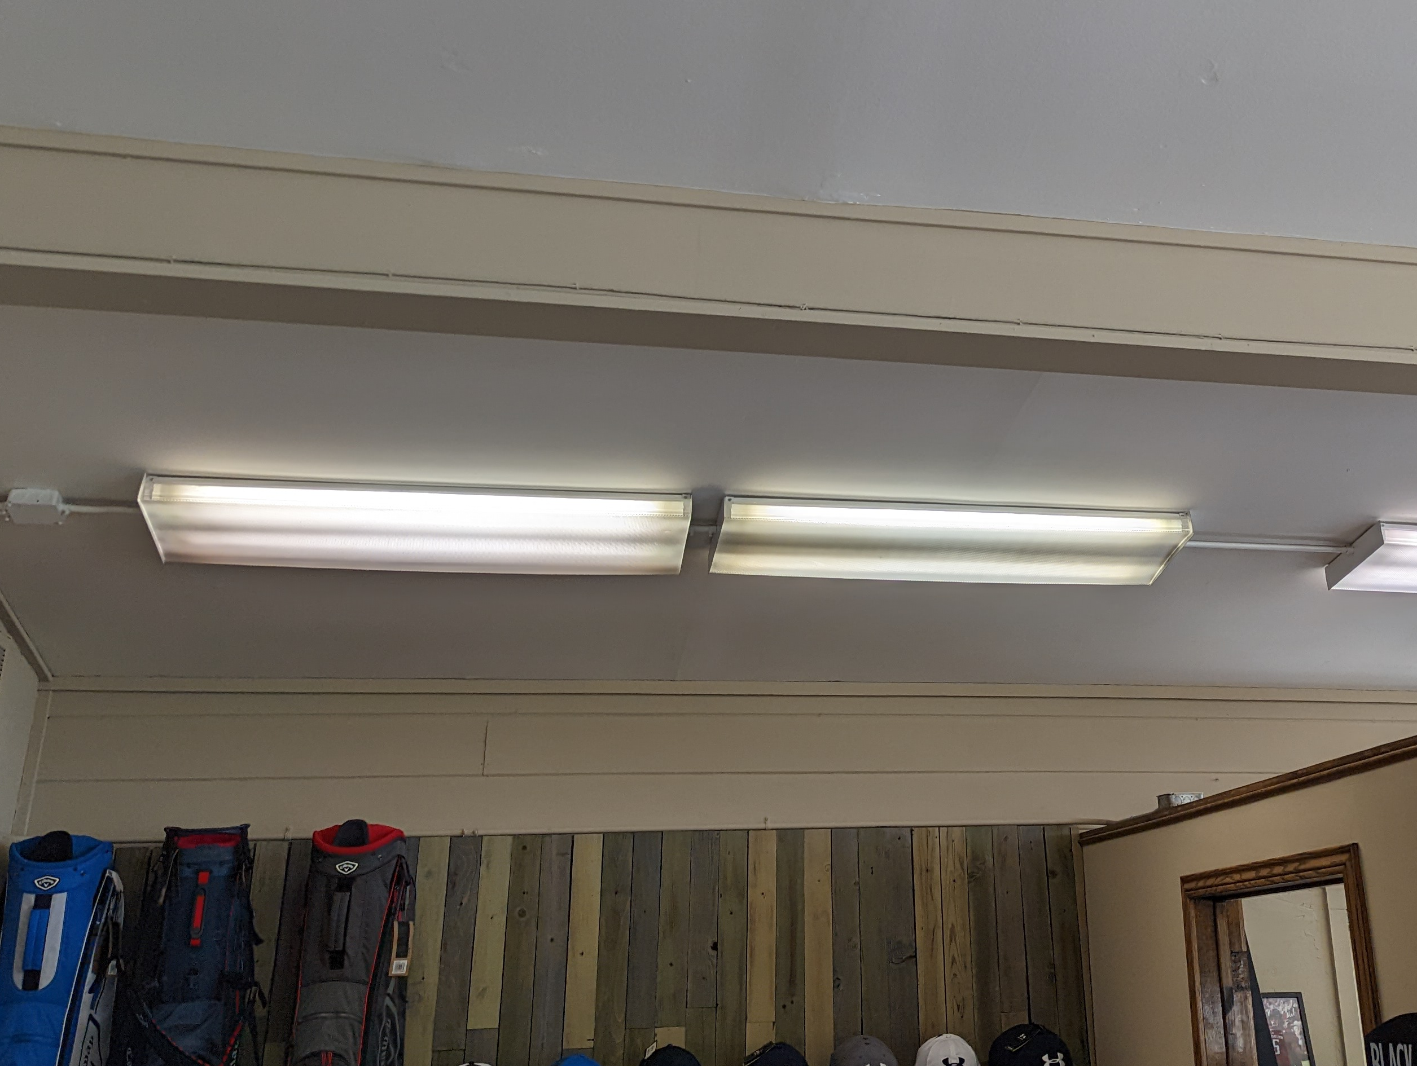
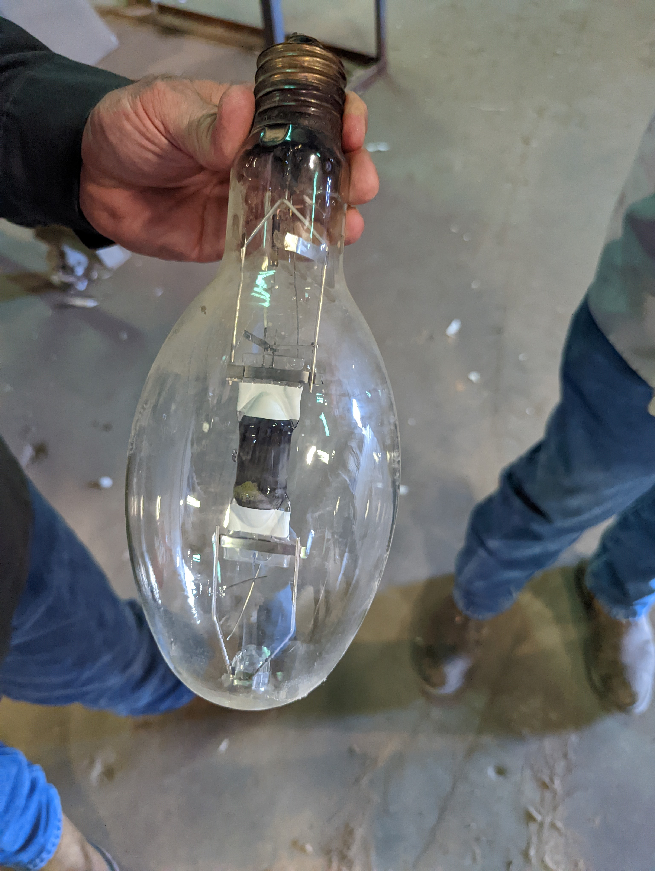
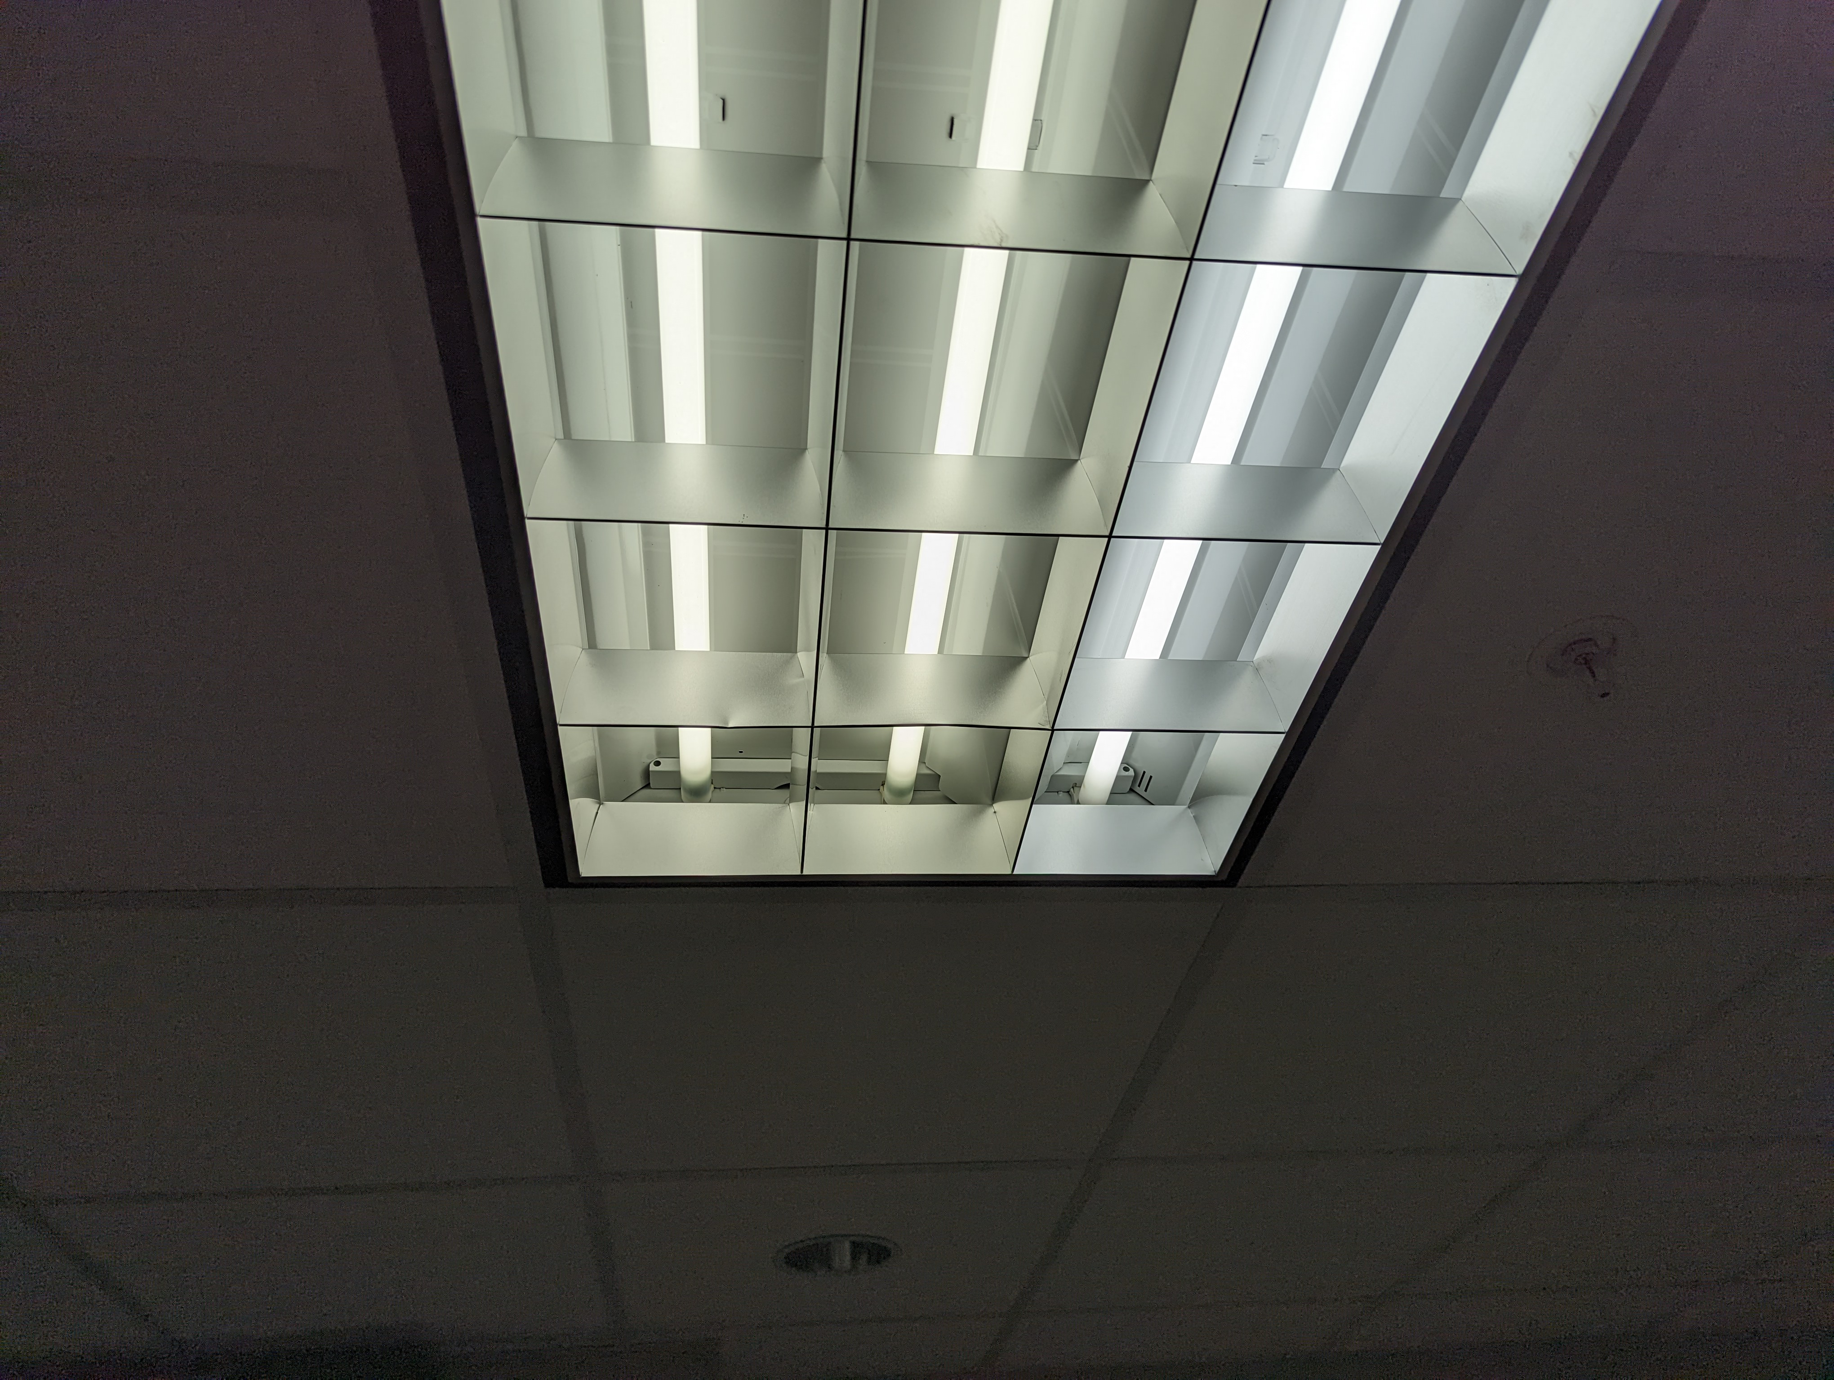
Facility Measure – Lighting Retrofits
Scope
Approximately 11 Buildings
Retrofit high visibility interior fixtures with architectural LED inserts
Retrofit interior fixtures with LED lamps
Retrofit exterior fixtures with LED fixtures
Benefits
Consistent inventory
Enhanced aesthetics
Reduce maintenance & energy costs
Reduced cooling load
5-10 Year Warranty on Lamps
Notes:
Standard Scope
Main City Hall
Recycling Center
Maintenance Shop
Central Fire Station
Country Club/Conference Center
Pro Shop
Fire Station
Rotary Community Center
Service Center/Warehouse
Fair Theater
Public Library

Slide 19
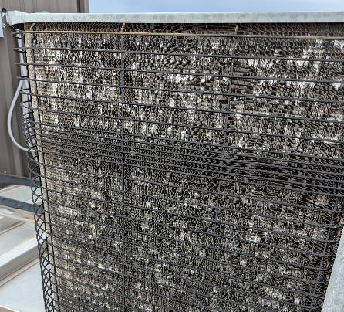
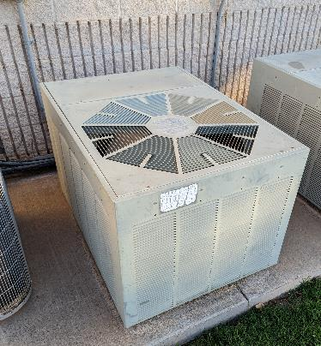
Facility Measure – HVAC Replacements
Scope
City Hall
Replace 6 Split System Condensers
Replace 2 Packaged Units including new Economizers
Country Club
Replace 7 Split Systems
Fire Station
Replace 3 Split Systems
Solid Waste Management
Replace and relocate 1 Split System
Hail Damaged Condenser
Condenser c.1993
Benefits
Improve reliability & occupant comfort
Reduce energy & maintenance costs
Address deferred maintenance issues
Address refrigerant accessibility issues
Avoid emergency repairs with planned replacements
Notes:
Addresses all old R-22 systems
Standard Scope
Main City Hall – Condensers and Coils only except RTUs - AVERAGE AGE 21 Years
Country Club/Conference Center – Split Systems (condensers, furnace, and coil) – AVERAGE AGE 18 Years
Fire Station – Split Systems (condensers, furnace, and coil) - AVERAGE AGE 23 Years
Solid Waste Facility – Split Systems (condensers, furnace, and coil) as well as relocated to get refrigerant lines out of the ground. Also adding new programmable thermostat. – 15 YEARS

Slide 20
Other Measure Reviewed but Not Developing
Energy Measures at WWTP
Operationally very efficient for the type of treatment facility
VFD’s are already identified as projects
Solar & Renewable Energy
Xcel Energy policy makes low to medium scale solar and renewable energy cost prohibitive when grid tied.
Water Conservation
Buildings faucets and toilets are already low flow
Minimal opportunity with irrigation systems

Slide 21
1. Meter Test Results
2. Baseline Data
3. Revenue Recovery
4. Utility & Labor Savings

Slide 22
AWWA Meter Accuracy Test Results
Minimum flow accounts for most residential leaks/water loss
13 meters tested 0% in the low flow category
1 meter tested 0% in all 3 flow categories
Meter will be removed from results since it showed historical consumption
12 of the 68 meters had a weighted average below 85%
Average consumption reading for meters tested was 1,293,268 gal
AWWA Standards – 15% allocated to Min; 70% allocated to Medium; And 15% allocated to Max

Slide 23
Weighted Meter Accuracy Test Results (5/8” x 3/4”)
Total 5/8 x 3/4 meters in database = 6,351
Average Used for Baseline Calculations 93.86%

Slide 24
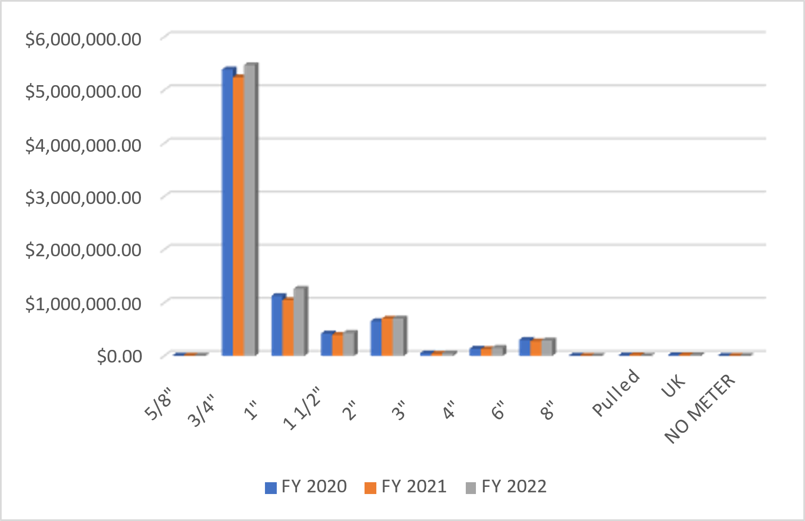
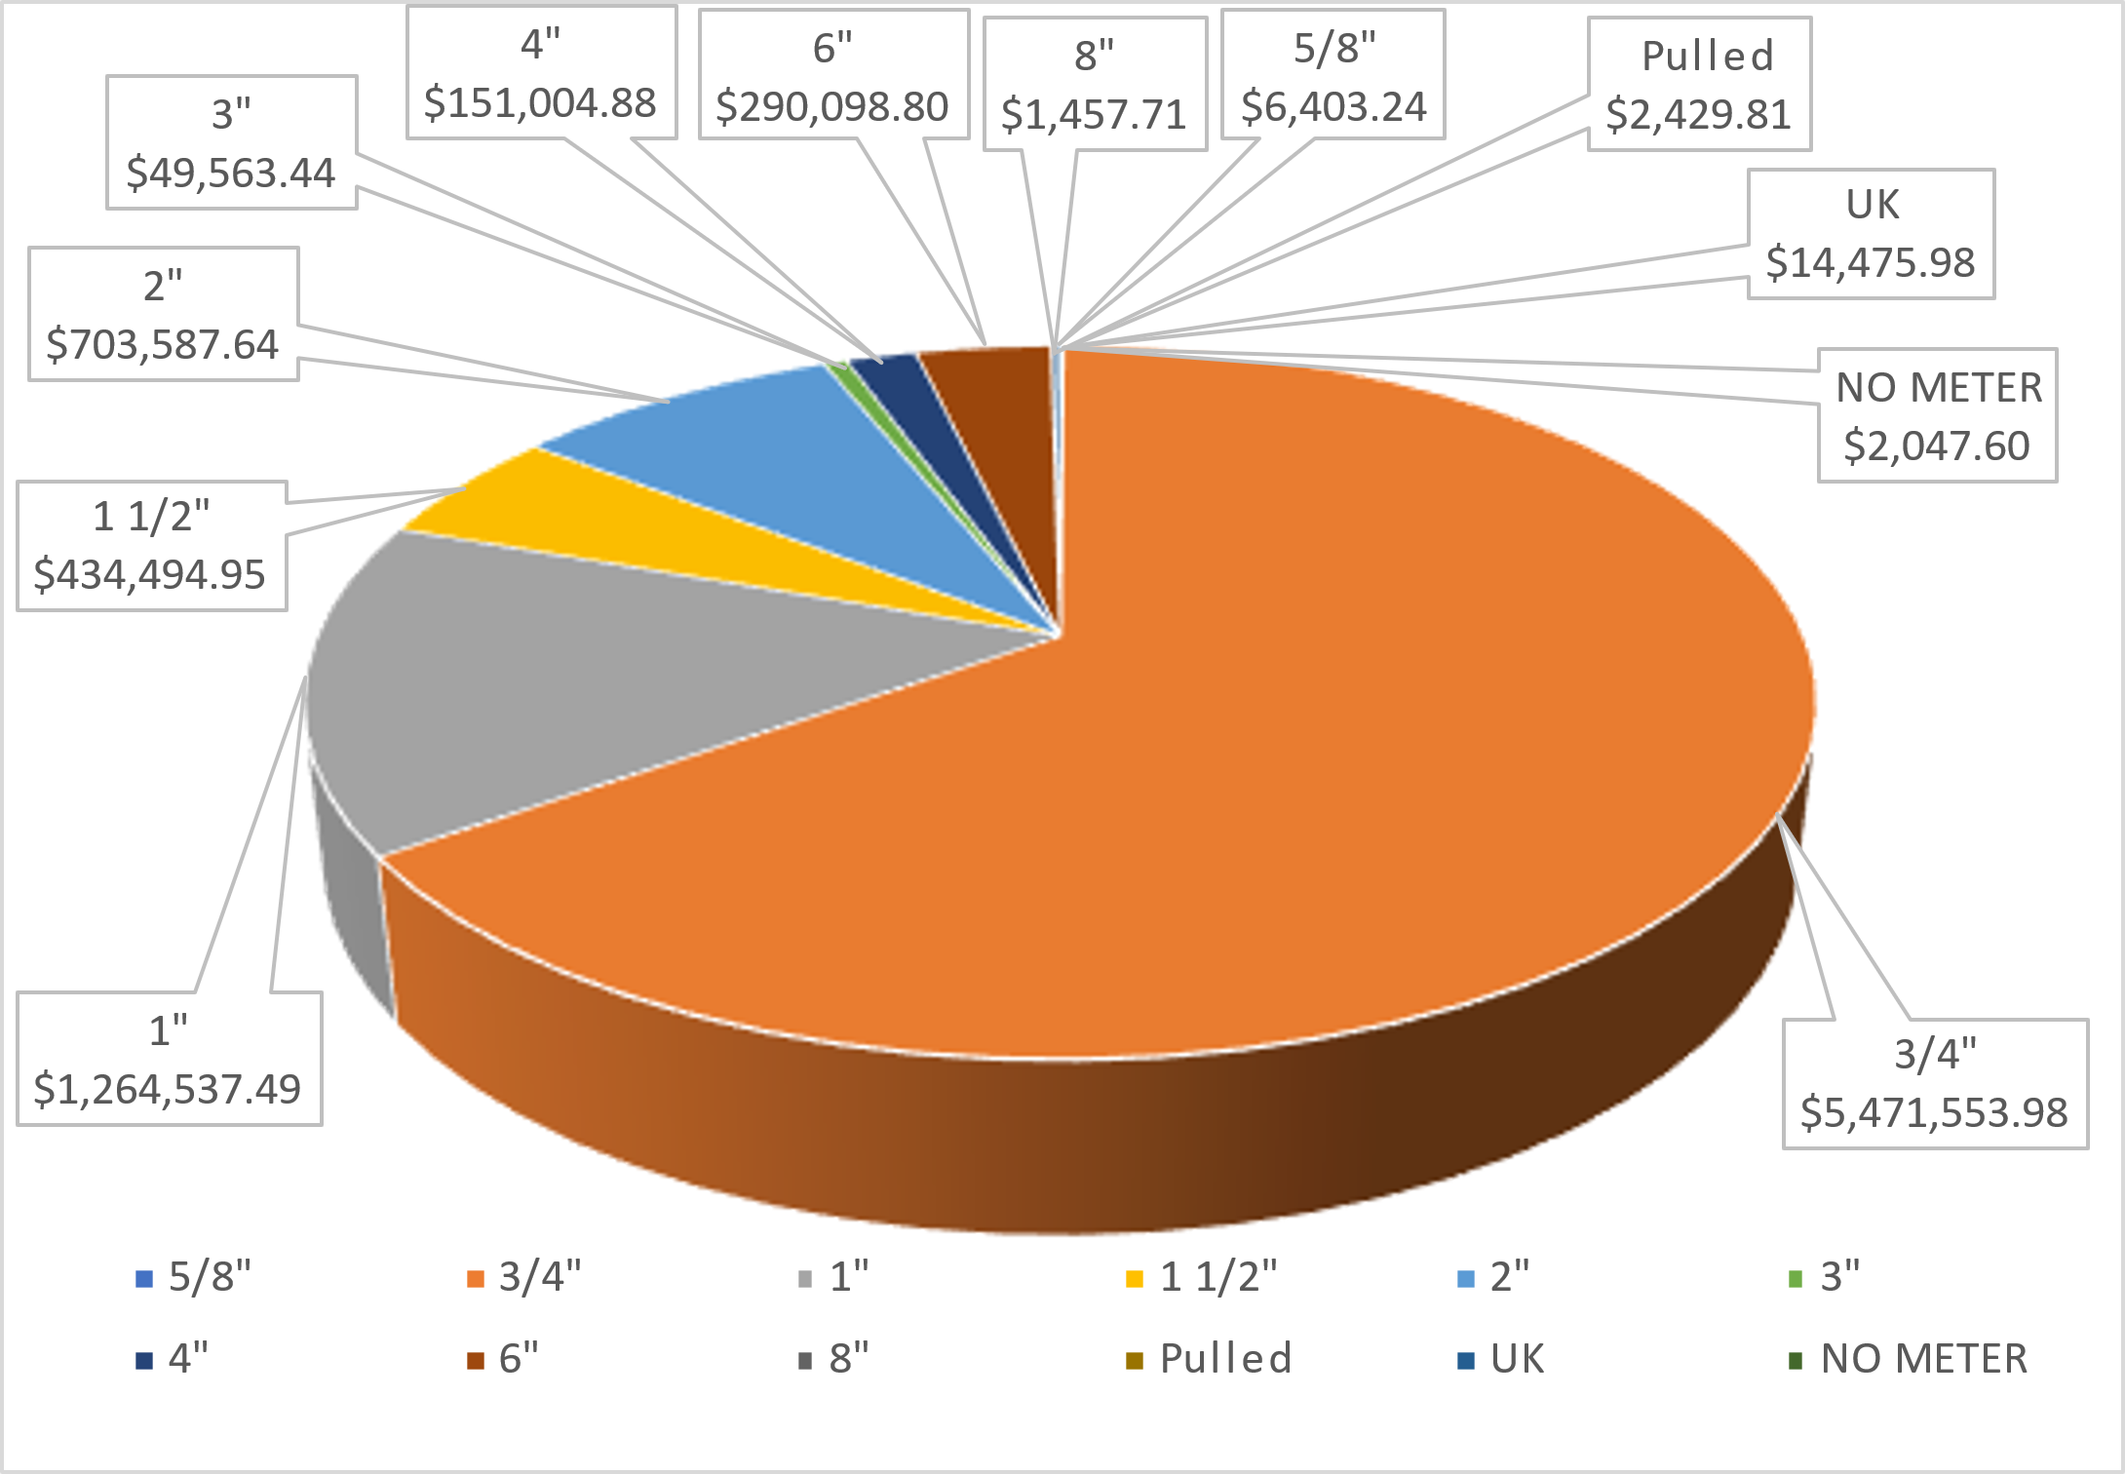
Water & Sewer Revenues
Billed Water & Sewer Revenue
2022 Revenue by Meter Size
Total Water and Sewer Revenues = $8,258,267
*Billed Base Charges and Consumption Charges
‘Base Rate’ Water & Sewer Revenues = ~$ 4,156,037 (50.4%)
‘Consumption’ Water & Sewer Revenues = ~$4,102,230 (49.6%)

Slide 25
Revenue Projections (Numbers are Approximate)
Clarifications & Assumptions
3% Rate Increase per year
0.3% Accuracy Degradation per year on exiting baseline
Majority of meters tested 93.9% average = .32%
Same baseline accuracy applied to 1.5” and 2” meters
Revenue Recovery Projections
Water & Sewer Revenue for 1” and smaller
Year 1 = ~$143,500
20 Yr. Total = ~$3,850,000
Water & Sewer Revenue for 1.5” & 2”
Year 1 = ~$44,000
20 Yr. Total = ~$1,180,000
Water & Sewer Meter Degradation for 2” and smaller
Year 2 = ~$9,800
20 Yr. Total = ~$1,200,000
2022 Water & Sewer Consumption Revenues = $4,102,230
Year 1 Revenue Recovery = $187,500 (4.5%)

Slide 26
Utility & Labor Savings Projections (Savings are Approximate)
Clarifications & Assumptions
3.53% Electric Rate Escalation
4.36% Natural Gas Rate Escalation
4% Meter Reading Labor Escalation
4% Hardware/Material Escalation
Savings Projections
Year 1 - Meter Reading/Ops Savings - ~$84,000
20 Yr. Total = ~$2,500,000
Year 1 – Hardware/Material Savings - ~$40,000
20 Yr. Total = ~$1,200,000
Year 1 – Electrical Savings = ~$25,600
20 Yr. Total = ~$725,500

Slide 27
Next Steps
Provide Scope Direction
Finalize Pricing
Conduct 3rd Party Review
Finalize Contract Documents
Aaron Stone
Sr. Project Developer
775-287-6856
astone@ameresco.com
Angela Hedgecock
Project Leader
856-776-9194
ahedgecock@ameresco.com
Chad Nobles
Account Executive
346-273-5005
cnobles@ameresco.com
Deval Allums
Account Executive
713-818-8641
dallums@Ameresco.com

